Slide 1


Pivotal Cloud Foundry
The Cloud Native Platform
Mike Wright
Platform Architect Manager - Southeast
Pivotal, Inc
mwright@pivotal.io
Notes:
Resting slide on screen before you begin presenting.

Slide 2


OUR MISSION:
Enable creation of high-quality software—at start-up speed—leveraging a modern cloud platform, a modern development process, and the power of Big Data to continuously drive innovation
Modern Software Methodology
Modern Cloud Platform
Big Data
Notes:
Businesses really face two very big challenges. How do they acquire the technical capability? How they transform the culture of the organization, to realize the full potential of these capabilities.

Slide 3



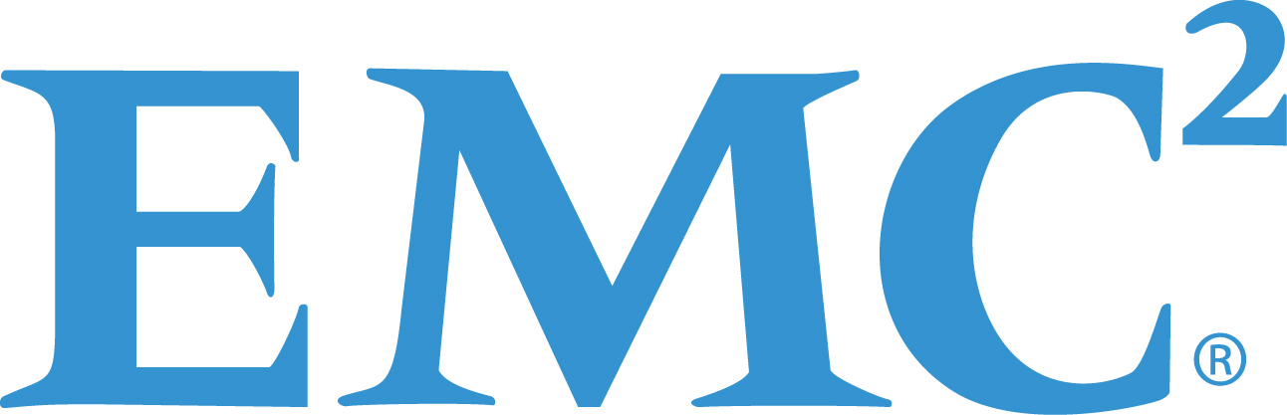
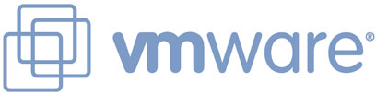
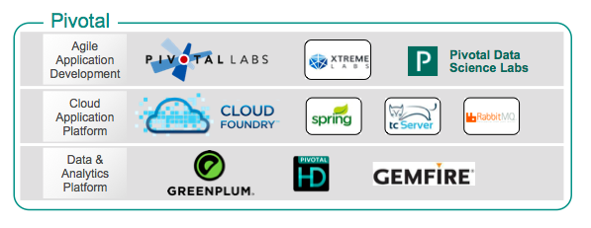
What is Pivotal?
$105M
investment
for 10%
“SPIN OUT”
(on April 1, 2013)
…to focus on the intersection of big / fast data, cloud native software development and the enablement of continuous delivery

Slide 4
The promise of Cloud Native
Deploy new features daily to production
Automate middleware
Free/Cheap horizontal scaling
Contract between App & Platform
Always available
Notes:
Agility & Productivity
Usability
Scalability
Consistency, Security
Resiliency

Slide 5
Defining Cloud-Native (AKA: ‘Agility, Agility, Agility’)
Cloud Native is not about where you run apps, but how
‘Twelve-Factor’ Architecture
Microservices Designs
“Antifragility”
Containers
The Application “Dial Tone”
Cultural Shift from Silo IT to DevOps

Slide 6
The Cloud Platform Evolution
Business Value, Agility & Cost Savings
Traditional IT
IaaS
PaaS
Applications
Applications
You Manage
Applications
Data
Data
Data
You Manage
Runtime
Runtime
Runtime
Middleware
Middleware
Middleware
You Manage
O/S
O/S
O/S
PivotalCF +
Virtualization
Virtualization
Virtualization
Servers
Servers
IaaS
Servers
IaaS
Storage
Storage
Storage
Networking
Networking
Networking
Level of Abstraction

Slide 7
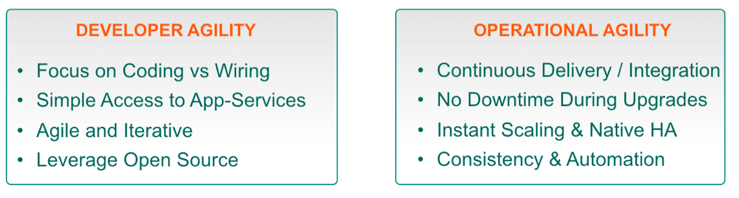
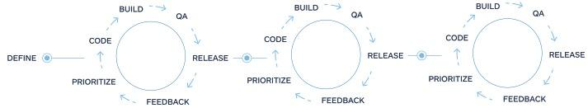

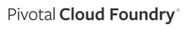
Software Factory
Agile Development + An Open Platform
Continuously Delivering
Time to Value
Define
Design
Build
Deploy
Operate

Slide 8



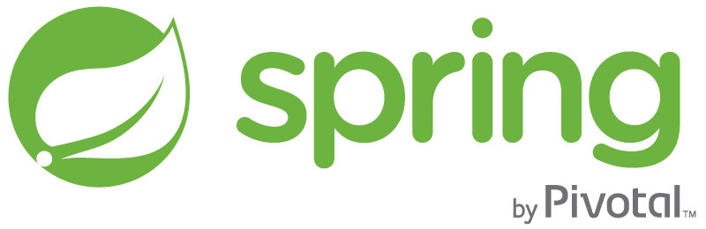


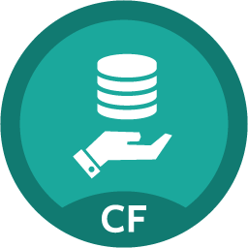

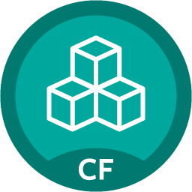

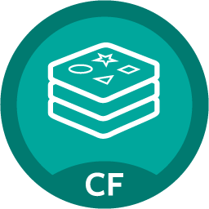
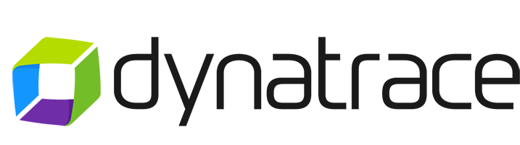

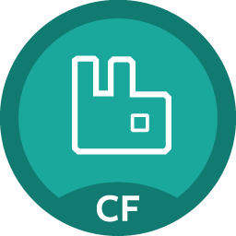

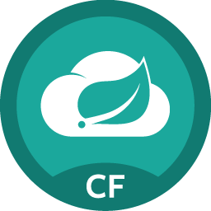
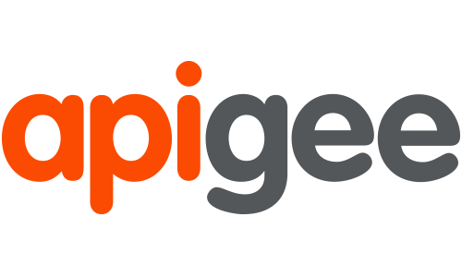
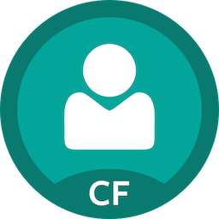

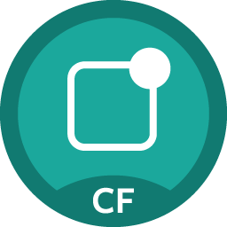
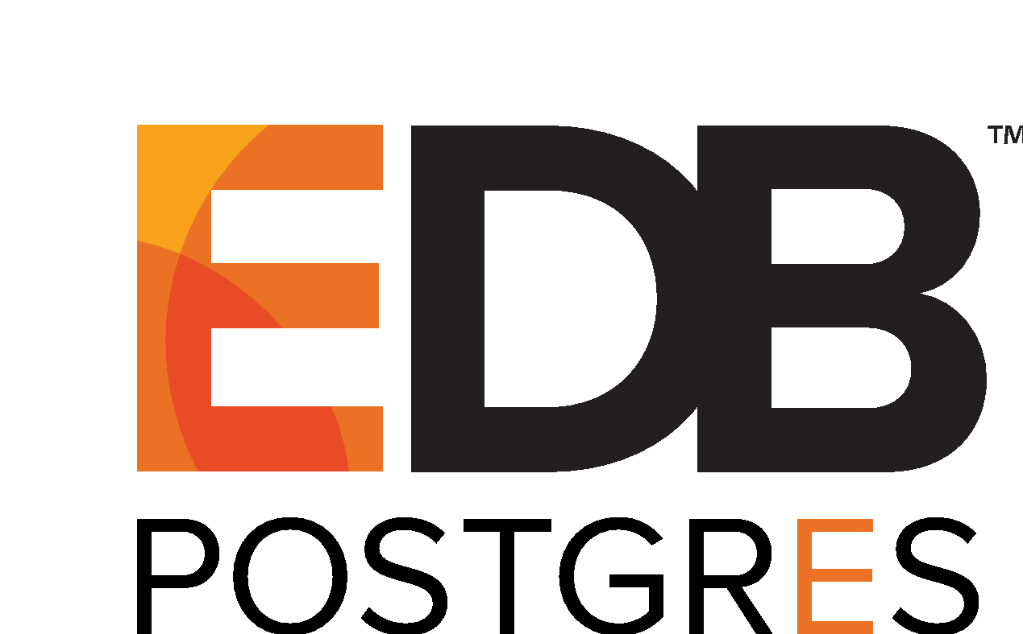
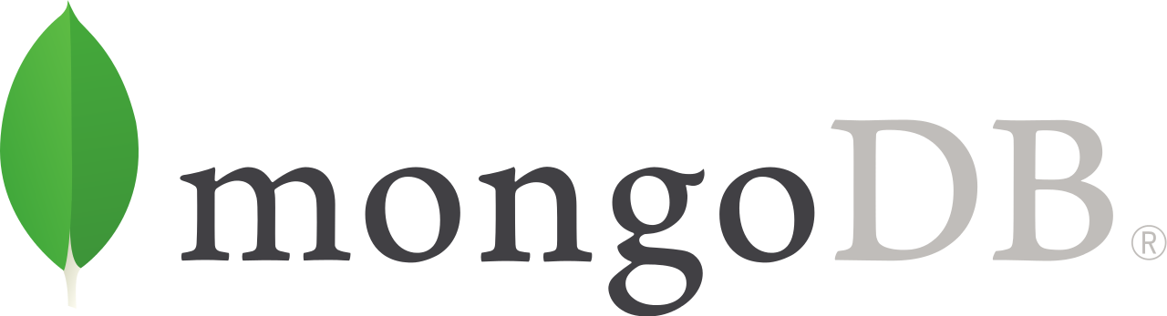
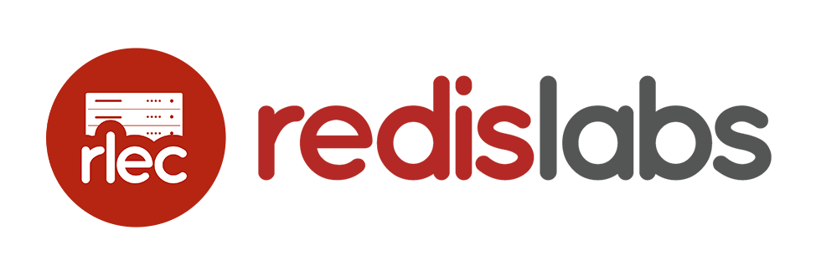



Applications/APIs/Microservices
BOSH Managed
Services
Brokered Services
MySQL
Greenplum DB
Pre-packaged container deployed and managed by platform
PIVOTAL
Compiled, staged, containerized, deployed and managed by platform
Gemfire
HDB
Java | .NET | Ruby | Node.js | Python | PHP | Go
…
Redis
PCF Elastic Runtime
PIVOTAL
RabbitMQ
Automated, Polyglot Build/Package/Deploy
Container Scheduling
Elastic (Auto)Scale
Spring Cloud
Services
PCF Tools
Single Sign On
PARTNERED
z
• Apps Manager UI
(App Admin UI)
• CLI
• REST APIs
• PCF Metrics
Dashboard
Integrated Logging/Metrics*
(Application & Platform)
Dynamic Routing & Extensible Route Services
Dev + Ops Role-Based Self-Service Access
Mobile Push Notifications
…
Security
(Application & Platform)
Self-Healing &
High Availability
(Application & Platform)
Zero Downtime Upgrades & ccccches
(Application & Platform)
PARTNER
Dingo PostgreSQL
…
Oracle DB
GitLab/Artifactory/Jenkins
…
MS SQL Server
USER PROVIDED
Infrastructure Automation
(BOSH)
Active MQ
Ops Manager UI
(Cloud Admin UI)
Infrastructure Agnostic Software Packaging
Multi-Cloud Orchestration of Infrastructure Provisioning
IBM DB/2
Distributed Software Configuration and Health/Lifecycle Management
…
Infrastructure
VMware
(vSphere + Photon)
OpenStack
Microsoft
Azure
Google
Cloud Platform
Amazon
Web Services
*Integration with various 3rd party visualization and management vendors
Notes:
Holistic, comprehensive, structured, opinionated, open platform

Slide 9
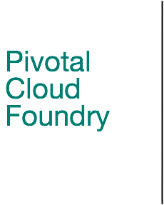
Developer’s Productivity

Slide 10
The developer dream haiku
Here is my source code,
Run it in the Cloud for me,
I do not care how

Slide 11
Deploying Apps Shouldn’t Be Painful (.NET)
Traditional
Provision a VM, IP, DNS
Install IIS
Install .NET FWK
Deploy Application
Configure Load Balancer
Configure SSL Termination
Configure Firewall
Configure Monitoring
Configure Logging
Pivotal Cloud Foundry
cf push

Slide 12
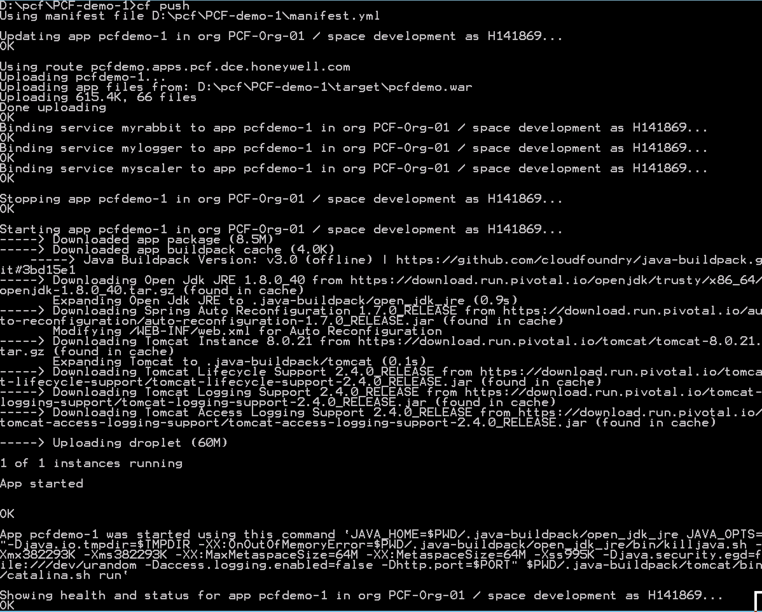
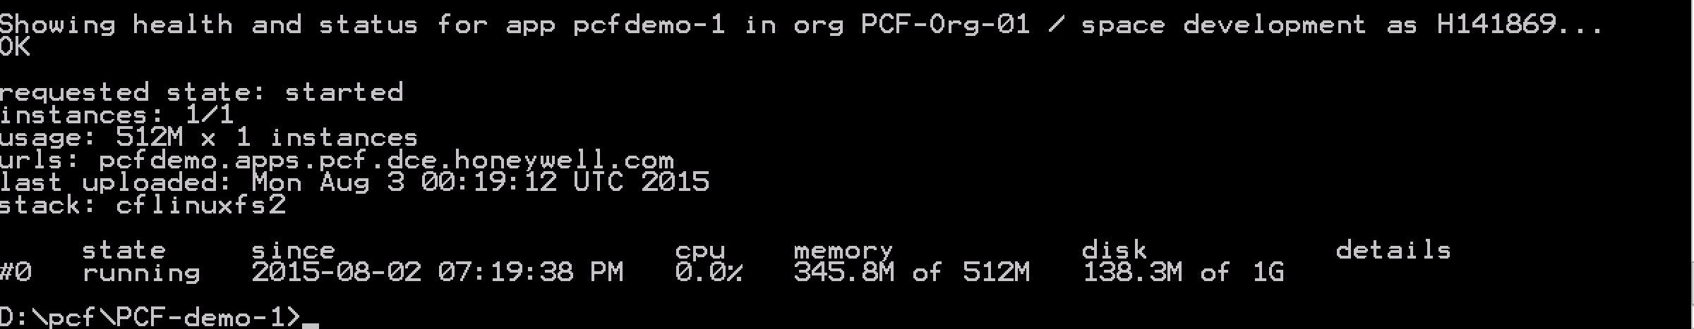
Enabling DevOps
Firewall & Routes
Service Bindings
App Lifecycle
Runtime Installation & Config
Middleware Installation & Config
Application Installation & Config
App Lifecycle
Logging, Health, Telemetry
Notes:
DevOps != infrastructure as code, or lots of scripting

Slide 13
Anatomy of the Platform

Slide 14




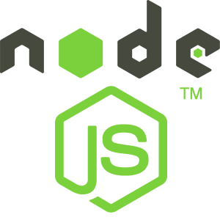



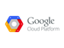
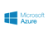
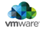
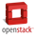
Anatomy of a Cloud Native Platform
Culture
Cloud Native Framework
Integrated Stack
Application Framework
Spring Boot
Spring Cloud
Spring Cloud Dataflow
.NET
Dev
Contract: 12 Factor App
Container Runtime
Cloud Foundry
Dev
IT Ops
Contract: BOSH Release
Infrastructure Automation
IT Ops
BOSH
Contract: Cloud Provider Interface
Infrastructure
IT Ops

Slide 15

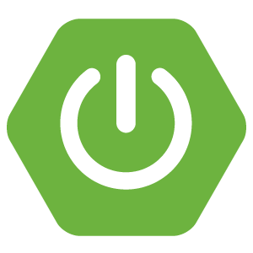

Application Framework
Spring Boot
Spring Cloud Dataflow
Spring Cloud
.NET
Dev
Spring Cloud Data Flow
Spring Boot
From 0 to app in < 5 min
Event-Driven Data Microservices
Spring Boot:
Is designed to get you up and running as quickly as possible, with minimal upfront configuration of Spring.
Takes an opinionated view of building production ready applications.
Build microservices with REST, WebSocket, Messaging, Reactive, Data, Integration, and Batch capabilities via a simple and consistent development experience.
Spring Cloud Dataflow provides:
Leverages Spring and Spring Boot
Orchestrable Data Microservices
Create flexible, robust and elastic and scalable data processing pipelines on demand
Ingest, transform and load data into concurrent and analytical data stores.

Slide 16


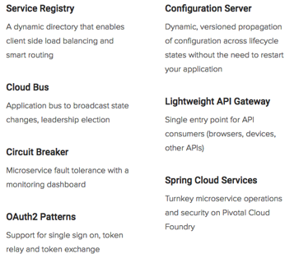
Application Framework
Spring Cloud Dataflow
Spring Cloud
.NET
Dev
Spring Cloud Services
Powered by Netflix OSS
Spring Cloud Services:
Which is built on Spring Boot simplifies distributed, microservice-style architecture by implementing proven patterns to bring resilience, reliability, and coordination to your microservices.
When used with PCF customers have a turnkey, secure solution for production operations of this coordination infrastructure—service registry, config server, and circuit breaker dashboard.
Coming to .NET in 2016! (Project SteelToe)

Slide 17
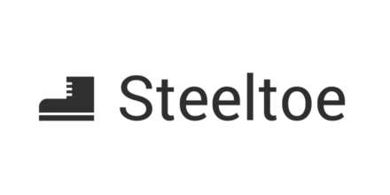


Spring Cloud Netflix for .NET: Project STEELTOE
Breaking the Monolith
Project Steeltoe contains best of breed components around configuration, service discovery, and soon, distributed tracing from NetflixOSS and Spring Cloud Services.
These can be used to evolve an infrastructure from a monolithic application to a set of microservices.
Write Once, Scale Anywhere
Project Steeltoe is built to work especially well with platforms like Pivotal Cloud Foundry. It also integrates seamlessly with Java microservices written with Spring Cloud, allowing for true polygot architecture.
Enterprise-ready .NET toolkit for common microservices patterns
http://steeltoe.io/

Slide 18








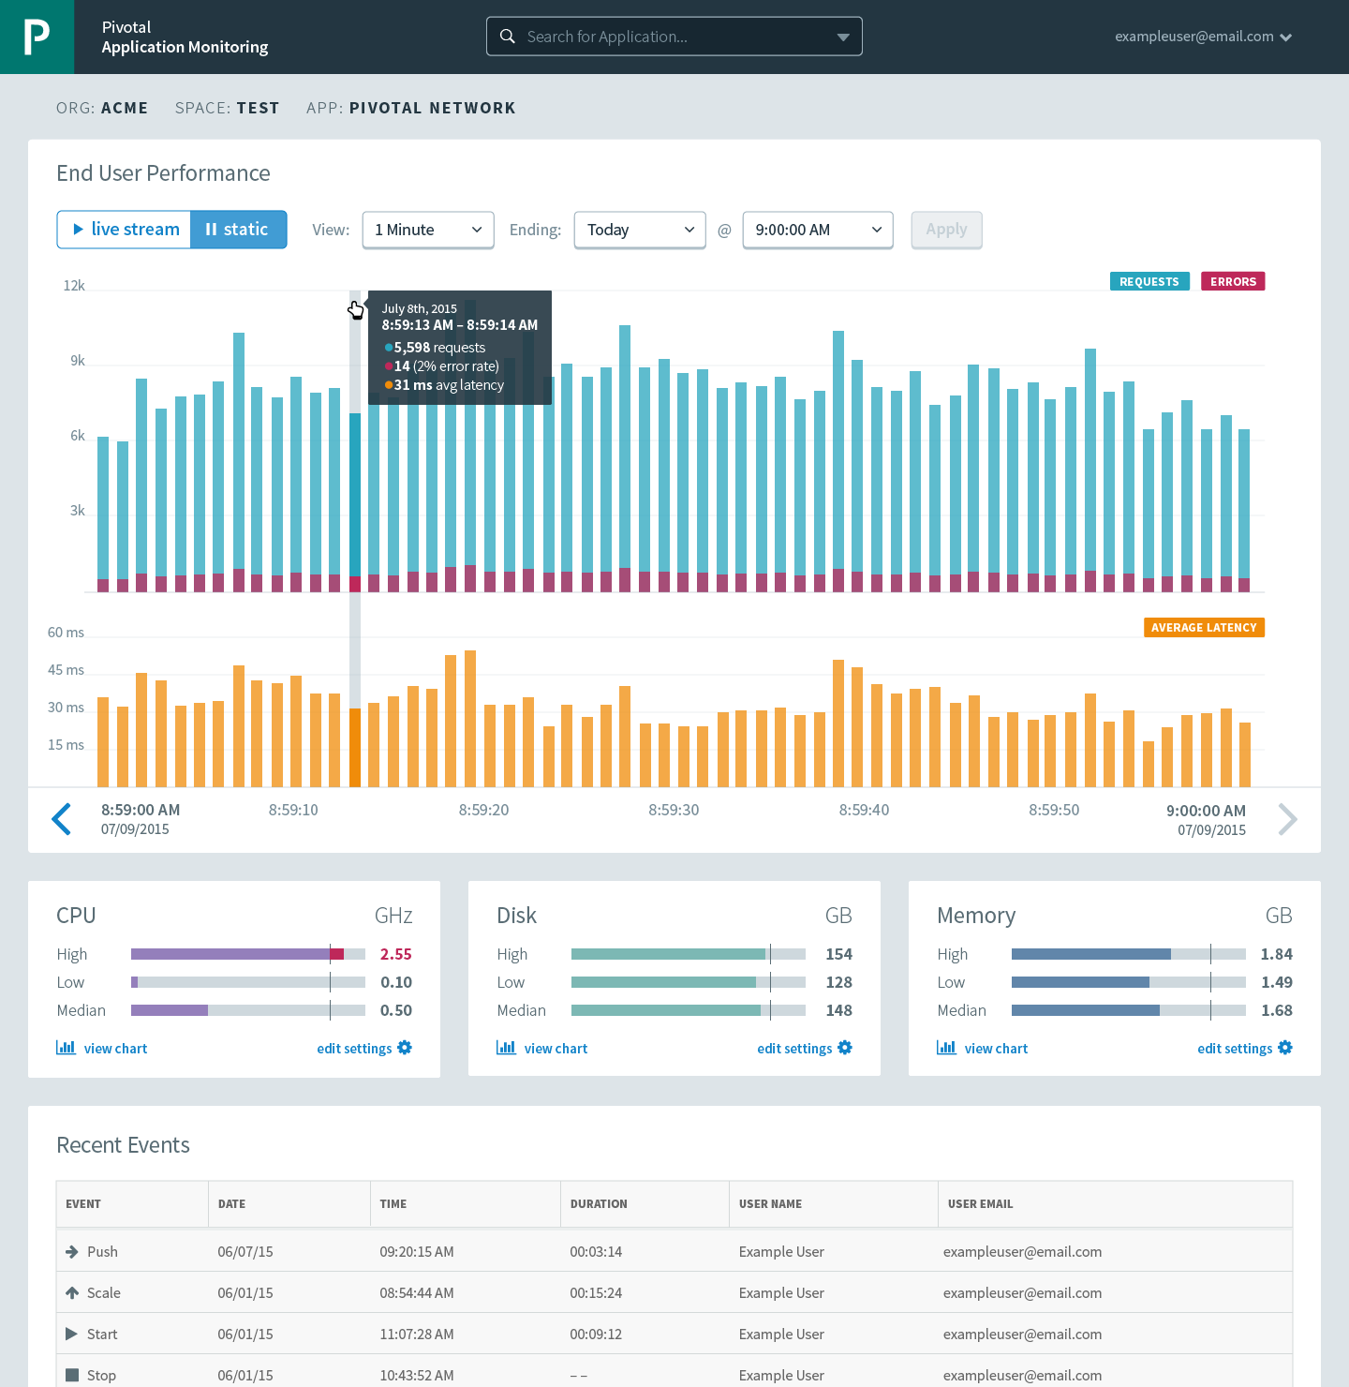



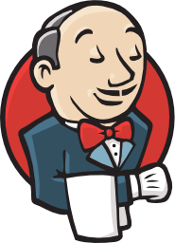

Container Runtime
Dev
IT Ops
Cloud Foundry
Mobile Integration
Centralized Log Management
Networking and Load Balancing
APM and Distributed Tracing
Scaling
Health management
APPLICATION
Full Stack CI/CD platform

Slide 19

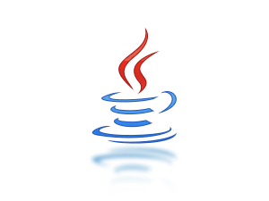


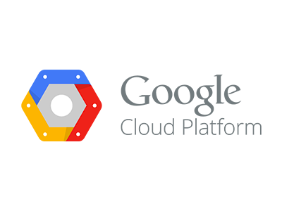

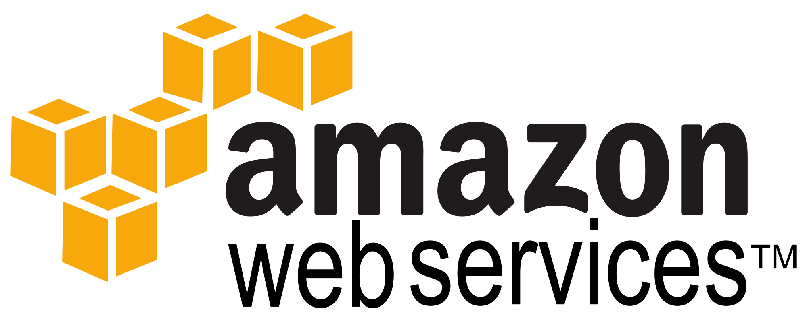

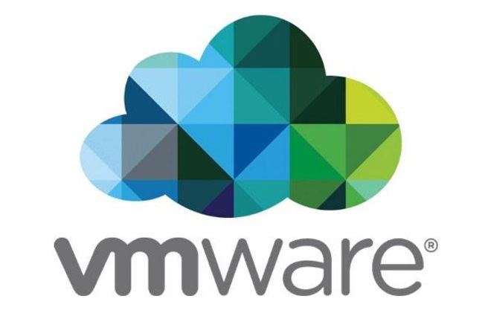

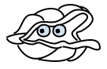
APPLICATION
Infrastructure as code
Security and Isolation
Language Agnostic
Integrated Data Services
Growing ISV and Partner Ecosystem
Infrastructure Agnostic and Utilization
Day 2 Operations
Infrastructure Automation
IT Ops
BOSH
Infrastructure
IT Ops

Slide 20
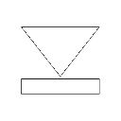


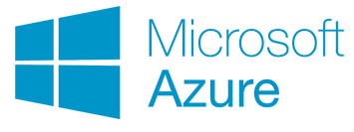


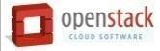

Pivotal Cloud Foundry Architecture
HA Proxy LB
Dynamic Router
Cloud Controller
CC-Bridge
UAA
Login Server
Service Broker
Diego
Service Nodes
Ops Manager UI
Auctioneer
BBS
Service
Ops Manager Director
CELL
CELL
Rep
Rep
Operations Manager
Service Broker
Executor
Executor
Service Nodes
+
=
Service
Messaging (NATS)
Metrics Collection
App Log Aggregator
Elastic Runtime

Slide 21
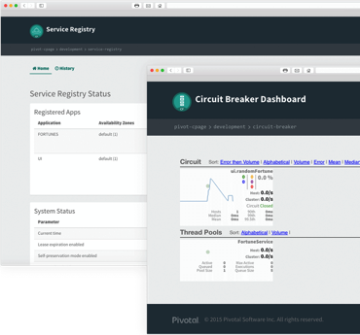
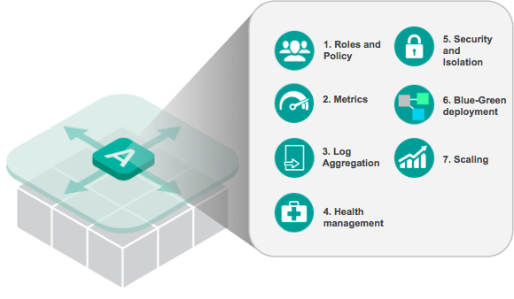
Everything Needed to Deploy and Operate an App

Slide 22
Containers and buildpacks

Slide 23
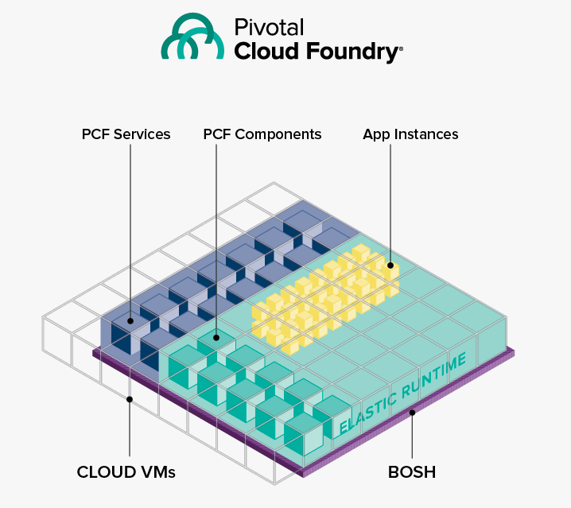
Pivotal Cloud Foundry - POWERED BY BOSH

Slide 24
Open Choice for Containers
PCF Buildpack Apps
BYO Container Apps
Developer brings app
Developer brings app
* Platform buildpacks provide standard runtime
AND
Developer brings runtime container image
Platform provides fixed OS container image
Developer brings container OS image
Dev Supported
PCF Supported
Platform provides fixed host OS & kernel
Platform provides fixed host OS & kernel
App container
* Devs may bring a custom buildpack

Slide 25

.NET App Evolution
Traditional
Architecture
Cloud Foundry Architecture
Windows VM
Windows VM
IIS
Container
App Pool
Container
Website
Hosted
Web Core
Hosted
Web Core
Container
Web App
Container
Hosted
Web Core
Web App
Hosted
Web Core
Web App
App Pool
Web App
Website
Website
Notes:
IIS is not used in garden-windows. We optionally provide a WebAppServer.exe which uses the same DLLs as IIS. Micro IIS. But pushed applications are not deployed using IIS, and IIS is not involved whatsoever.
But that should not matter to anyone using the platform. If you have an app that works when deployed to IIS, you can use WebAppServer.exe to run that application. And that is an implementation of Hosted Web Core.
Process isolation through Hostable Web Core (HWC) ~ Micro IIS

Slide 26
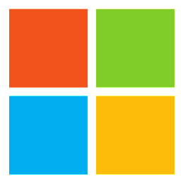
Garden Windows
resource isolation
kernel job object
disk quotas
namespace isolation
user accounts
Host Web Core
(an isolated IIS instance)
Dynamic Router
ROUTING
OAuth 2.0 Server (UAA)
Login Server
AUTHENTICATION
CC & CC Bridge
BBS
Converger
APP LIFECYCLE
BBS/etcd
MESSAGING
CELL
Blob Store
APP STORAGE
& EXECUTION
Windows 2012-R2 Cells
Garden
Build Packs
Sys Log
Collector
App Log
METRICS & LOGGING

Slide 27
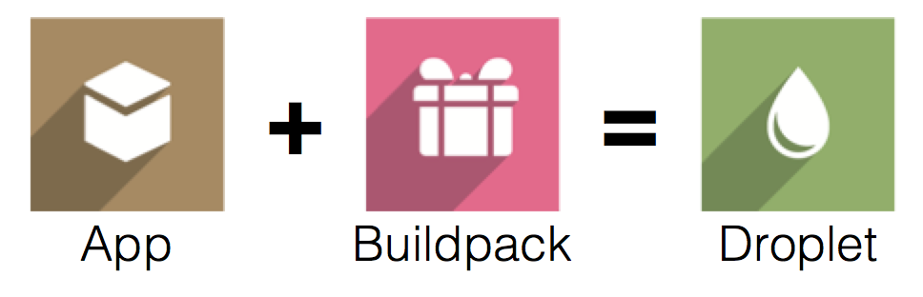
Buildpacks
Buildpacks installed into a Cloud Foundry instance or loaded from an external location at app deployment time
Buildpacks provided by public Cloud Foundry
Cloud Foundry Community Buildpack
Write your own
Java
Ruby
Node.js
Binary
Go
Python
PHP
Static file
.NET

Slide 28
Why Buildpacks
Control what frameworks/runtimes are used on the platform
Provides consistent deployments across environments
Stops deployments from piling up at operation’s doorstep
Enables a self-service platform
Eases ongoing operations burdens:
Security vulnerability is identified
Subsequently fixed with a new buildpack release
Restage applications

Slide 29
Services

Slide 30

Two Types of Services
Managed - Fully integrated, with full lifecycle management
User-Provided – Created and managed external to the platform

Slide 31
Cloud Foundry Services
A service is an external application dependency or component such as:
External state
Database, cache, message queue
Tools
Monitoring app, external logging sink, etc
External applications
Microservice, web service, legacy application
app instance
service1
services are external
to the app instance
service2

Slide 32
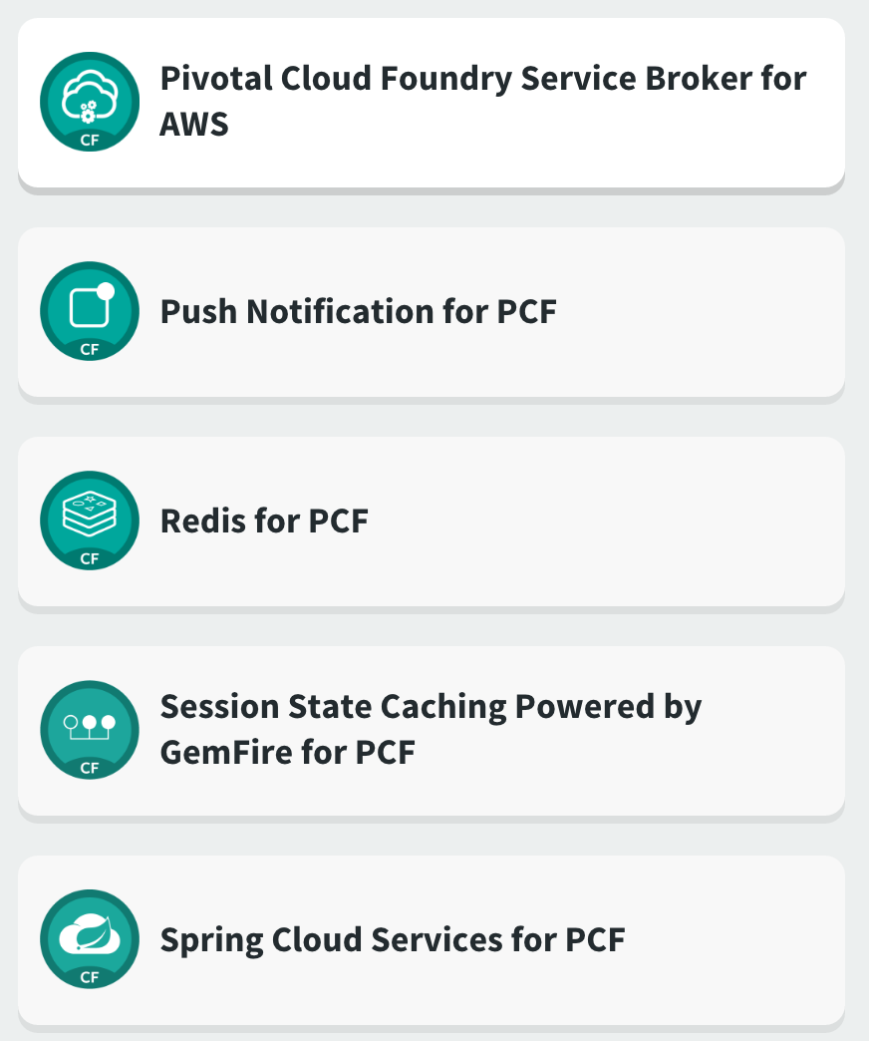
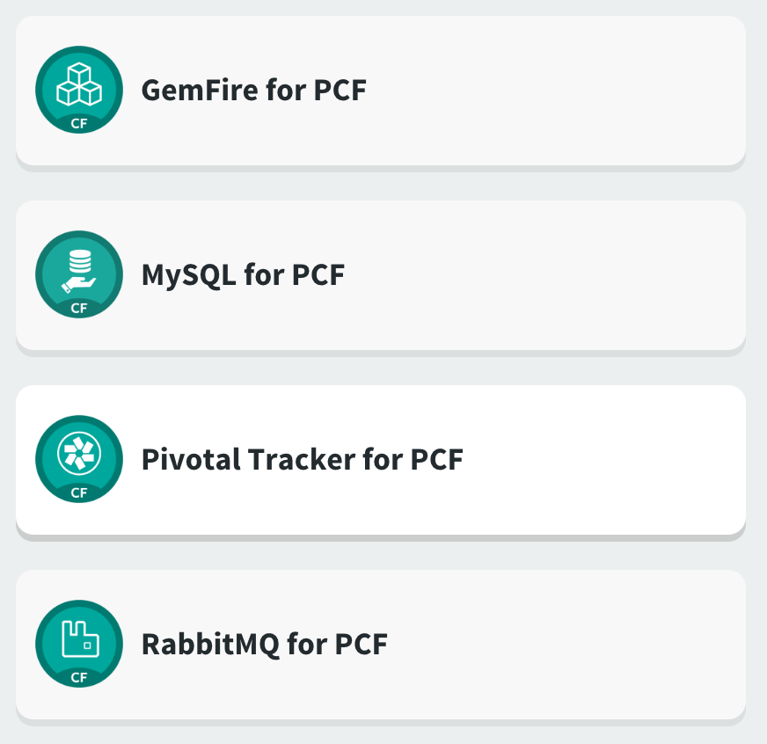

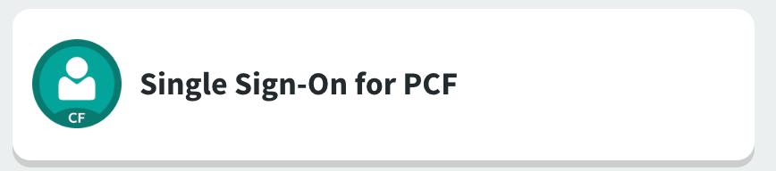
Marketplace - Pivotal Services
https://network.pivotal.io/

Slide 33
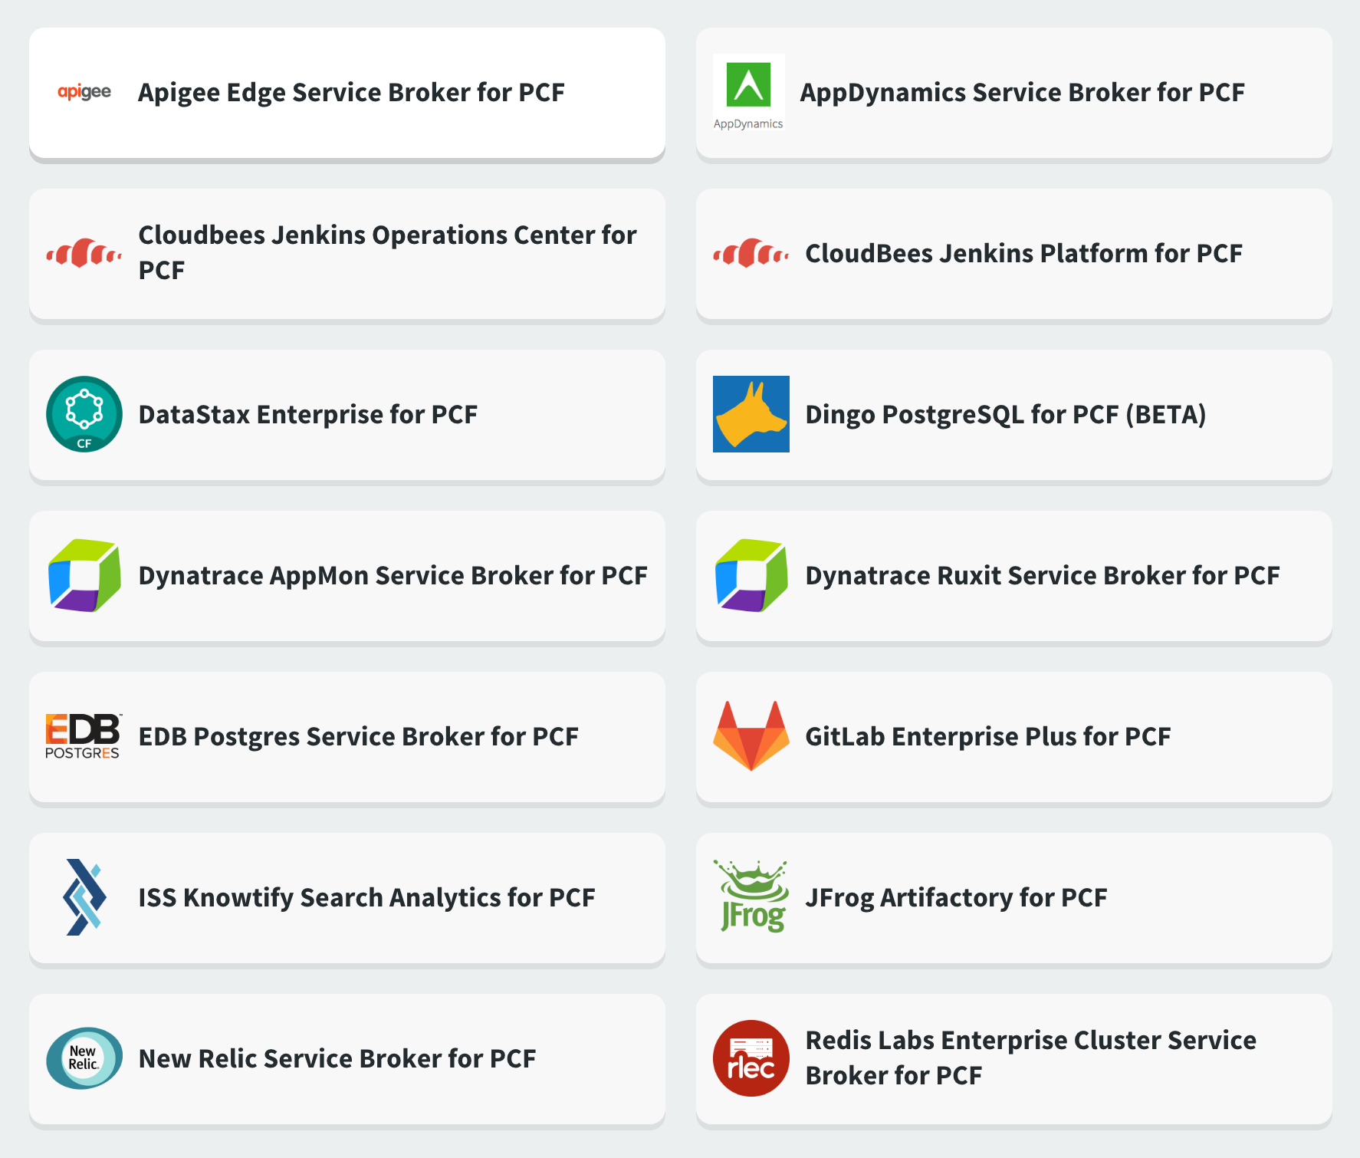

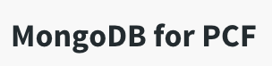
Marketplace - Partner Services
https://network.pivotal.io/

Slide 34

Creating and Binding a Service
Service
credentials
DB
CLI
create service (HTTP)
Cloud Controller
create service (HTTP)
Service
Broker
reserve resources
Data
Service
Router
bind service (HTTP)
bind service (HTTP)
obtain connection data
Elastic Runtime

Slide 35
User Provided Services
User-provided - A user-provided service is simply a list of connection parameters that are stored in the platform and provided to an application when it binds to the service.
User-provided services are useful for quickly getting parameters to an application, without having to create a service broker and registering with it the platform. They are also helpful for services that will probably only be used once or twice.
Applications connect to the same instance.
User-provided services are created using the CF CLI’s create-user-provided-service command, which takes an arbitrary set of key/value pairs as an argument.
Same portability for apps as with Service Brokers thanks to the Name Based Service Binding
> cf create-user-provided-service my-old-db –p ‘{“user”:”admin”,”password”:”pwd”}’
Full instructions can be found here https://docs.pivotal.io/pivotalcf/devguide/services/user-provided.html

Slide 36

VCAP_SERVICES
VCAP: short for VMware's Cloud Application Platform, in reference to the origins of the Cloud Foundry Platform.

Slide 37
Appendix

Slide 38
Zero-Downtime deployment

Slide 39





Blue-Green Deployment
https://docs.pivotal.io/pivotalcf/1-8/devguide/deploy-apps/blue-green.html

Slide 40
CI/CD

Slide 41



Application Lifecycle Management: CI/CD Delivery High Quality Software, Faster and Continuously From Idea to Production
AUTOMATION.
Integrate tools and automate processes from testing to builds and deployment
SPEED.
Release more frequently with smaller bits will reduce complexity and improve time-to-market
QUALITY.
Reduce feedback loop using test-driven development to surface problems sooner and be responsive
AGILITY.
Push updates on regular basis with no downtime to improve customer experience and time to market
Commit Code Change
Automate Build & Test
(Unit Test, Static Code Analysis)
Store Binaries & Build Artifacts
Automated Integration Testing
Acceptance, Performance & Load
Zero Downtime Upgrade to Production
Build Pipeline Operations
Tool Chain
Gitlab
Jenkins
Development
Test + UAT + Staging
Production
Distributed revision control and source code management. Collaborative software development
Build and test software projects continuously and incrementally. Hundreds of compatible plugins
Share binaries and manage distributions. Manage artifact lifecycle. Avoid license violations
Develop, test, QA and production on the same platform. Simple, developer friendly commands and APIs. Operational benefits for every app. Built-in ecosystem services. Deploy, operate and scale on any IAAS

Slide 42
Metrics

Slide 43
Application Performance Monitoring
PCF Metrics provides a real-time application monitoring dashboard
3rd Party Tiles provide in-depth monitoring of applications running on PCF via an embedded agent bundled with applications that are deployed using Buildpacks
Dynatrace
New Relic
AppDynamics

Slide 44

PCF Metrics

Slide 45



Thank You!

